Slide 1
360º Supplier Connect Compliance

Slide 2
Admin

Slide 3

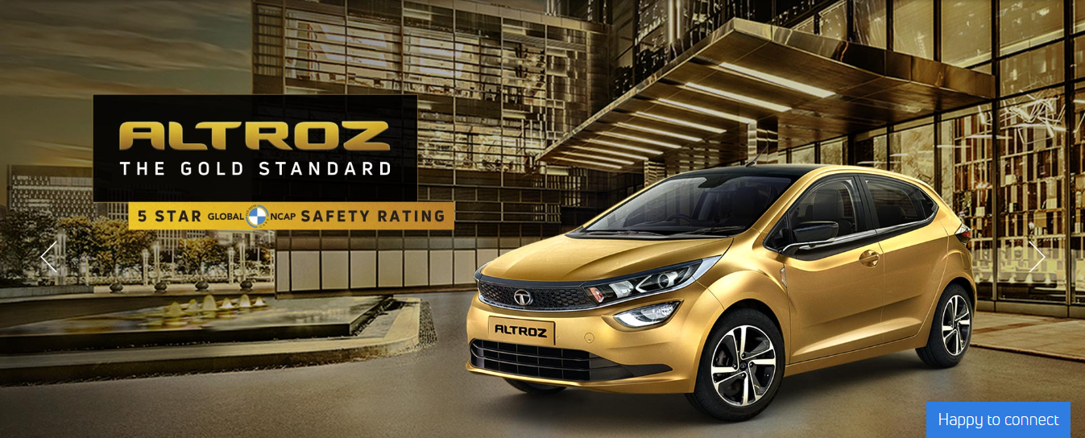

360º Supplier Connect
Admin
Search
Performance Insights
Data Exchange
Phygital MSA
Contact Profile
Compliance Admin Supplier View TML View
Reports
PPAP
How To?
Announcements
.
Any System related Messages will be displayed here

Slide 4
Compliance
Admin
Certificate Registration
Edit / Delete Certificate
Update Vendor Certificate
Certificate Name
Mention Certificate Name
Mandatory
Select (Yes / No)
Update
Post clicking on Certificate Registration tab, above screen will appear wherein Certificate Name (max 80 characters, alpha numeric with special characters to be allowed
In Mandatory tab selection of Yes / No to be provided.
Post clicking on Update button, mail to be triggered to Key Account Manager for updating Certificates
For mandatory certificates, reminder mails to be sent to Key Account Manager every 10 days till concerned Certificate is updated
Before 15 days of Certificate Expiry date, auto reminder mails to be sent to Key Account Manager to update revised Certificate

Slide 5


Compliance
Admin
Certificate Registration
Edit / Delete Certificate
Update Vendor Certificate
S N | Certificate Name | Mandatory | Updated By | Updated Date | Edit | Delete
1 | Factory Licence | Yes | Auto fetch | Auto fetch
2 | Consent to operate | Yes | Auto fetch | Auto fetch
3 | Fire NOC | Yes | Auto fetch | Auto fetch
4 | Environmental statement- Form V | No | Auto fetch | Auto fetch
5 | Stability certificate | Yes | Auto fetch | Auto fetch
6 | NOC from CGWA | No | Auto fetch | Auto fetch
7 | IATF 16949:2016 | Yes | Auto fetch | Auto fetch
8 | EMS Certificates ISO:14001 | No | Auto fetch | Auto fetch
Post clicking on Edit / Delete Certificate tab, above table to be displayed wherein existing certificates which are updated will be displayed

Slide 6


Compliance
Admin
Certificate Registration
Edit / Delete Certificate
Update Vendor Certificate
Vendor Code
Mention Vendor Code
Certificate Name
Select from dropdown
Proceed
S N | Certificate Name | Mandatory | Certifying Authority | Registrar Name | Registrar Email ID | Origin Email ID | Issue Date * | Expiry Date * | Place of Issue | Attachment *
1 | Factory Licence | Yes
Save
Post clicking on Update Vendor Certificate tab, above screen will appear wherein details and attachments can be updated

Slide 7
Supplier
(K01 login ID)

Slide 8
360º Supplier Connect
Supplier
Search
Performance Insights
Data Exchange
Phygital MSA
Contact Profile
Compliance Admin Supplier View TML View
Reports
PPAP
How To?
Announcements
.
Any System related Messages will be displayed here

Slide 9
Compliance
Supplier
Upload Certificates
View / Edit Certificate
Certificate Name
Select from dropdown
Proceed
S N | Certificate Name | Mandatory | Certifying Authority | Registrar Name | Registrar Email ID | Origin Email ID | Issue Date * | Expiry Date * | Place of Issue | Attachment *
1 | Factory Licence | Yes
Save
Post clicking on Upload Certificates tab, above screen will appear wherein post selection of Certificate from dropdown, details and attachments can be updated

Slide 10

Compliance
Supplier
Upload Certificates
View / Edit Certificate
S N | Certificate Name | Mandatory | Certifying Authority | Registrar Name | Registrar Email ID | Origin Email ID | Issue Date * | Expiry Date * | Place of Issue | Attachment * | Status | Submitted Date | Edit
1 | Factory Licence | Yes | Auto fetch | Auto fetch | Auto fetch | Auto fetch | Auto fetch | Auto fetch | Auto fetch |  | Updated | Auto fetch
2 | Consent to operate | Yes | Auto fetch | Auto fetch | Auto fetch | Auto fetch | Auto fetch | Auto fetch | Auto fetch |  | Updated | Auto fetch
3 | Fire NOC | Yes | Auto fetch | Auto fetch | Auto fetch | Auto fetch | Auto fetch | Auto fetch | Auto fetch |  | Updated | Auto fetch
4 | Environmental statement- Form V | No |  |  |  |  |  |  |  |  | Pending
Post clicking on View / Edit Certificates, all details which Supplier has updated will be displayed
After clicking on Edit button, Supplier should be able to Edit updated details and also can upload revised attachment if required. Versions to be maintained for updated details
Status colour – Yellow - Updated post expiry of earlier certificate validity, Green – Updated prior expiry of earlier certificate validity, Red – Pending for updation

Slide 11
Supplier
(G01 login ID)

Slide 12
360º Supplier Connect
Supplier
Search
Performance Insights
Data Exchange
Phygital MSA
Contact Profile
Compliance Admin Supplier View TML View
Reports
PPAP
How To?
Announcements
.
Any System related Messages will be displayed here

Slide 13
Compliance
Supplier
Upload Certificates
View / Edit Certificate
Vendor Code
Select Vendor Code from dropdown
Certificate Name
Select from dropdown
Proceed
S N | Certificate Name | Mandatory | Certifying Authority | Registrar Name | Registrar Email ID | Origin Email ID | Issue Date * | Expiry Date * | Place of Issue | Attachment *
1 | Factory Licence | Yes
Save
For Group Vendor Code login ID, in Vendor Code selection box, all Vendor Codes related to that Group User ID to get displayed in selection list and details and attachments can be updated fro selected Vendor Code

Slide 14
Compliance
Supplier
Upload Certificates
View / Edit Certificate
Vendor Code
Select Vendor Code from dropdown
Proceed
S N | Certificate Name | Mandatory | Certifying Authority | Registrar Name | Registrar Email ID | Origin Email ID | Issue Date * | Expiry Date * | Place of Issue | Attachment * | Status | Submitted Date | Edit
1 | Factory Licence | Yes | Auto fetch | Auto fetch | Auto fetch | Auto fetch | Auto fetch | Auto fetch | Auto fetch |  | Updated | Auto fetch
2 | Consent to operate | Yes | Auto fetch | Auto fetch | Auto fetch | Auto fetch | Auto fetch | Auto fetch | Auto fetch |  | Updated | Auto fetch
3 | Fire NOC | Yes | Auto fetch | Auto fetch | Auto fetch | Auto fetch | Auto fetch | Auto fetch | Auto fetch |  | Updated | Auto fetch
4 | Environmental statement- Form V | No |  |  |  |  |  |  |  |  | Pending
Post clicking on View / Edit Certificates, all details which Supplier has updated will be displayed for selected Vendor Code
After clicking on Edit button, Supplier should be able to Edit updated details and also can upload revised attachment if required. Versions to be maintained for updated details
Status colour – Yellow - Updated post expiry of earlier certificate validity, Green – Updated prior expiry of earlier certificate validity, Red – Pending for updation

Slide 15
Supplier
(M01 login ID)

Slide 16
360º Supplier Connect
Supplier
Search
Performance Insights
Data Exchange
Phygital MSA
Contact Profile
Compliance Admin Supplier View TML View
Reports
PPAP
How To?
Announcements
.
Any System related Messages will be displayed here

Slide 17
Compliance
Supplier
S N | Certificate Name | Mandatory | Certifying Authority | Registrar Name | Registrar Email ID | Origin Email ID | Issue Date * | Expiry Date * | Place of Issue | Attachment * | Status | Submitted Date
1 | Factory Licence | Yes | Auto fetch | Auto fetch | Auto fetch | Auto fetch | Auto fetch | Auto fetch | Auto fetch |  | Updated | Auto fetch
2 | Consent to operate | Yes | Auto fetch | Auto fetch | Auto fetch | Auto fetch | Auto fetch | Auto fetch | Auto fetch |  | Updated | Auto fetch
3 | Fire NOC | Yes | Auto fetch | Auto fetch | Auto fetch | Auto fetch | Auto fetch | Auto fetch | Auto fetch |  | Updated | Auto fetch
4 | Environmental statement- Form V | No |  |  |  |  |  |  |  |  | Pending
Above table to be displayed wherein details and attachments can be viewed
Status colour – Yellow - Updated post expiry of earlier certificate validity, Green – Updated prior expiry of earlier certificate validity, Red – Pending for updation

Slide 18
360º Supplier Connect
TML User
Search
Performance Insights
Data Exchange
Phygital MSA
Contact Profile
Compliance Admin Supplier View TML View
Reports
PPAP
How To?
Announcements
.
Any System related Messages will be displayed here

Slide 19
Compliance
TML User
View Certificates
Download all Details
Vendor Code
Select Vendor Code from dropdown
Certificate Name
Select from dropdown
Proceed
S N | Certificate Name | Mandatory | Certifying Authority | Registrar Name | Registrar Email ID | Origin Email ID | Issue Date * | Expiry Date * | Place of Issue | Attachment * | Status | Submitted Date
1 | Factory Licence | Yes | Auto fetch | Auto fetch | Auto fetch | Auto fetch | Auto fetch | Auto fetch | Auto fetch |  | Updated | Auto fetch
2 | Consent to operate | Yes | Auto fetch | Auto fetch | Auto fetch | Auto fetch | Auto fetch | Auto fetch | Auto fetch |  | Updated | Auto fetch
Download
Post clicking on View Certificates tab, above screen to be displayed wherein in Certificate dropdown list, All and other certificate name to be displayed. Default it should be All
Post clicking on Download tab, all details except attachment should get downloaded in Excel sheet
Status colour – Yellow - Updated post expiry of earlier certificate validity, Green – Updated prior expiry of earlier certificate validity, Red – Pending for updation

Slide 20
Compliance
TML User
View Certificates
Download all Details
Certificate Name
Select from dropdown
Download
Post clicking on Download all details tab, above screen to be displayed wherein in Certificate dropdown list, All and other certificate name to be displayed. Default it should be All
Post clicking on Download tab, all details except attachment should get downloaded in Excel sheet

